Slide 1
Announcements
Homework 1: Search
Due yesterday
“Show Answer”
Project 1: Search
Has been released! Due Friday 2/7 at 5pm.
Start early and ask questions. It’s longer than most!
Solo or in group of two. For group of two: both of you need to submit your code into edX!
Homework 2: CSPs
About to be released! Part I AND Part II due Monday, 2/10, at 11:59pm.
Part I through edX – online, instant grading, submit as often as you like.
Part II through www.pandagrader.com -- submit pdf
Exam conflicts
Midterm dates have been set
If you have a conflict, email us at cs188-staff@lists.berkeley.edu by tonight.

Slide 2
Announcements
Sections
You can go to any, but have priority in your own.
101 Th 2-3 John S. / Anna 55
102 Th 4-5 John D. / James 40
103 Th 5-6 Peter 20
104 Th 6-7 Abhishek 10
105 Fr 9-10 Ankush 25
106 Fr 10-11 Teodor/Michael 25
107 Fr 11-noon Teodor/Michael 25
108 Fr noon-1 Kevin/Alvin 40

Slide 3

Happy New Year!

Slide 4

BBC (this past weekend)

Slide 5
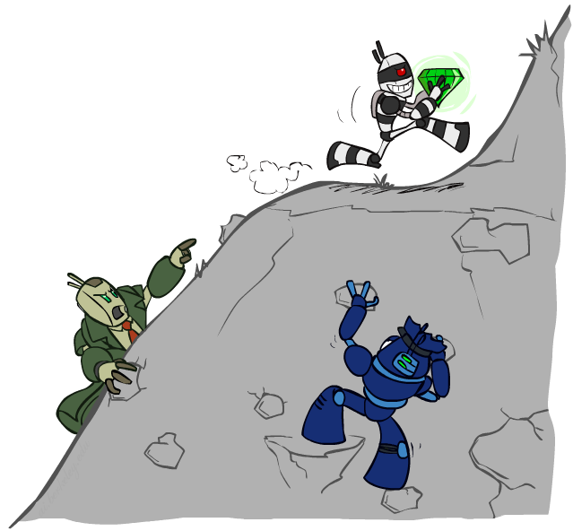
CS 188: Artificial Intelligence
Constraint Satisfaction Problems II
Instructors: Dan Klein and Pieter Abbeel
University of California, Berkeley
[These slides were created by Dan Klein and Pieter Abbeel for CS188 Intro to AI at UC Berkeley. All CS188 materials are available at http://ai.berkeley.edu.]
Notes:
Please retain proper attribution, including the reference to ai.berkeley.edu. Thanks!

Slide 6

Today
Efficient Solution of CSPs
Local Search

Slide 7


Reminder: CSPs
CSPs:
Variables
Domains
Constraints
Implicit (provide code to compute)
Explicit (provide a list of the legal tuples)
Unary / Binary / N-ary
Goals:
Here: find any solution
Also: find all, find best, etc.

Slide 8
Backtracking Search

Slide 9
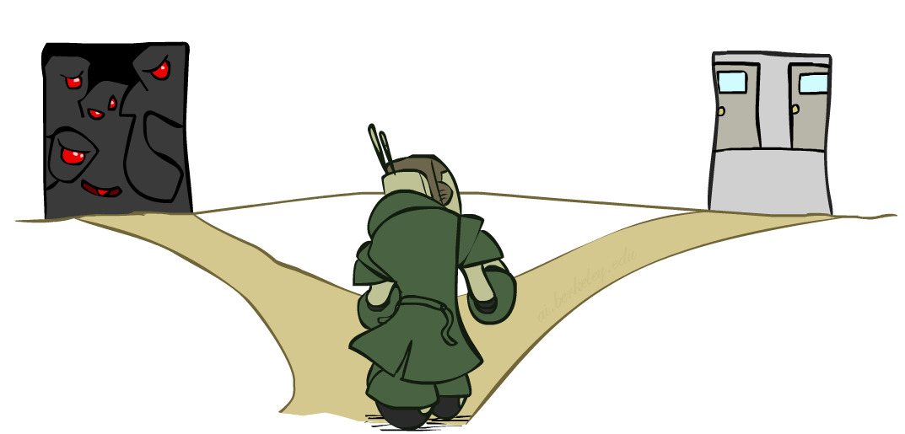

Improving Backtracking
General-purpose ideas give huge gains in speed
… but it’s all still NP-hard
Filtering: Can we detect inevitable failure early?
Ordering:
Which variable should be assigned next? (MRV)
In what order should its values be tried? (LCV)
Structure: Can we exploit the problem structure?

Slide 10

Arc Consistency and Beyond

Slide 11
Arc Consistency of an Entire CSP
A simple form of propagation makes sure all arcs are simultaneously consistent:
Arc consistency detects failure earlier than forward checking
Important: If X loses a value, neighbors of X need to be rechecked!
Must rerun after each assignment!
NT
Q
WA
SA
NSW
V
Remember: Delete from the tail!

Slide 12
Limitations of Arc Consistency
After enforcing arc consistency:
Can have one solution left
Can have multiple solutions left
Can have no solutions left (and not know it)
Arc consistency still runs inside a backtracking search!
What went wrong here?

Slide 13
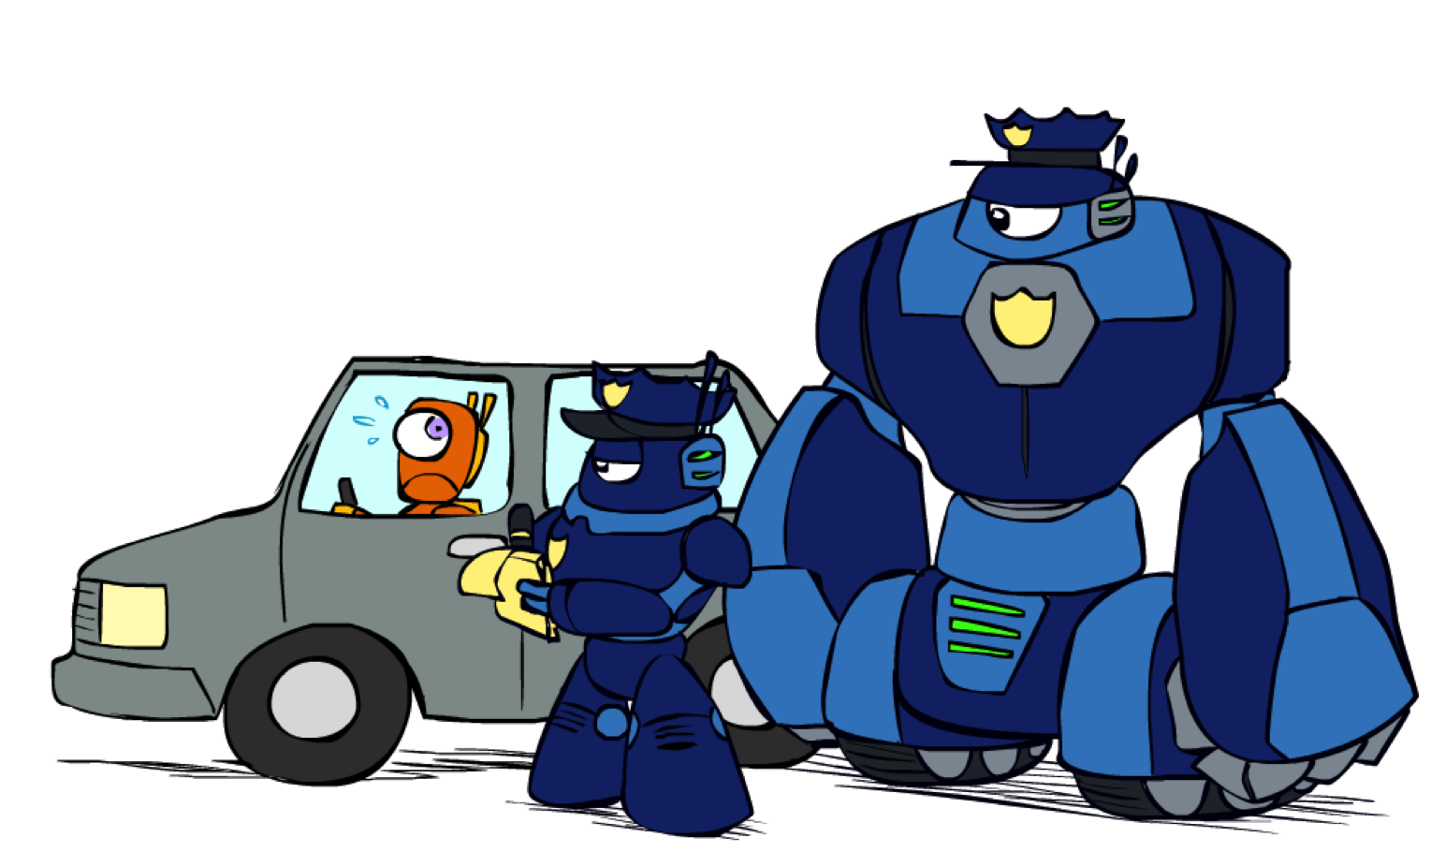
K-Consistency

Slide 14
K-Consistency
Increasing degrees of consistency
1-Consistency (Node Consistency): Each single node’s domain has a value which meets that node’s unary constraints
2-Consistency (Arc Consistency): For each pair of nodes, any consistent assignment to one can be extended to the other
K-Consistency: For each k nodes, any consistent assignment to k-1 can be extended to the k^{th} node.
Higher k more expensive to compute
(You need to know the k=2 case: arc consistency)

Slide 15
Strong K-Consistency
Strong k-consistency: also k-1, k-2, … 1 consistent
Claim: strong n-consistency means we can solve without backtracking!
Why?
Choose any assignment to any variable
Choose a new variable
By 2-consistency, there is a choice consistent with the first
Choose a new variable
By 3-consistency, there is a choice consistent with the first 2
…
Lots of middle ground between arc consistency and n-consistency! (e.g. k=3, called path consistency)

Slide 16
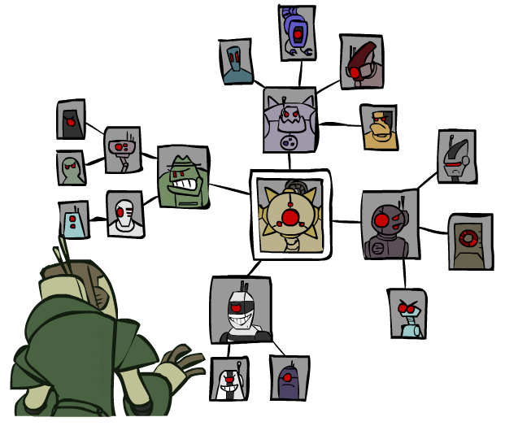
Structure

Slide 17
Problem Structure
Extreme case: independent subproblems
Example: Tasmania and mainland do not interact
Independent subproblems are identifiable as connected components of constraint graph
Suppose a graph of n variables can be broken into subproblems of only c variables:
Worst-case solution cost is O((n/c)(d^{c})), linear in n
E.g., n = 80, d = 2, c =20
2⁸⁰ = 4 billion years at 10 million nodes/sec
(4)(2²⁰) = 0.4 seconds at 10 million nodes/sec

Slide 18
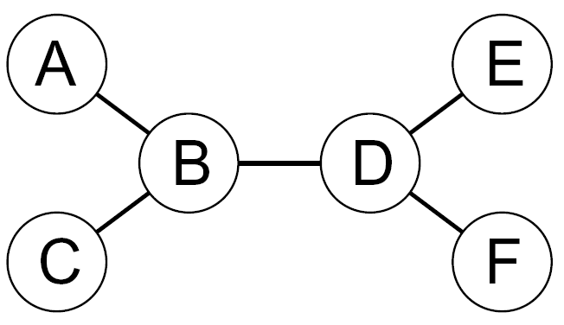
Tree-Structured CSPs
Theorem: if the constraint graph has no loops, the CSP can be solved in O(n d²) time
Compare to general CSPs, where worst-case time is O(d^{n})
This property also applies to probabilistic reasoning (later): an example of the relation between syntactic restrictions and the complexity of reasoning

Slide 19
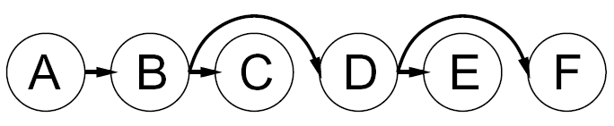
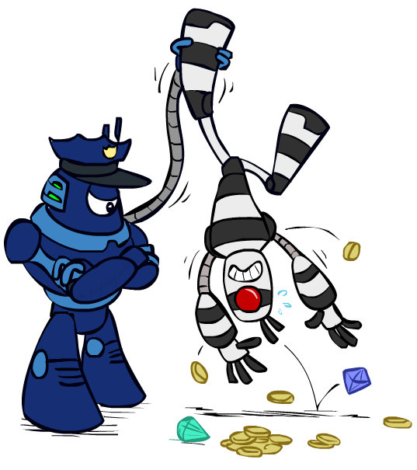

Tree-Structured CSPs
Algorithm for tree-structured CSPs:
Order: Choose a root variable, order variables so that parents precede children
Remove backward: For i = n : 2, apply RemoveInconsistent(Parent(X_{i}),X_{i})
Assign forward: For i = 1 : n, assign X_{i} consistently with Parent(X_{i})
Runtime: O(n d²) (why?)

Slide 20
Tree-Structured CSPs
Claim 1: After backward pass, all root-to-leaf arcs are consistent
Proof: Each X→Y was made consistent at one point and Y’s domain could not have been reduced thereafter (because Y’s children were processed before Y)
Claim 2: If root-to-leaf arcs are consistent, forward assignment will not backtrack
Proof: Induction on position
Why doesn’t this algorithm work with cycles in the constraint graph?
Note: we’ll see this basic idea again with Bayes’ nets

Slide 21
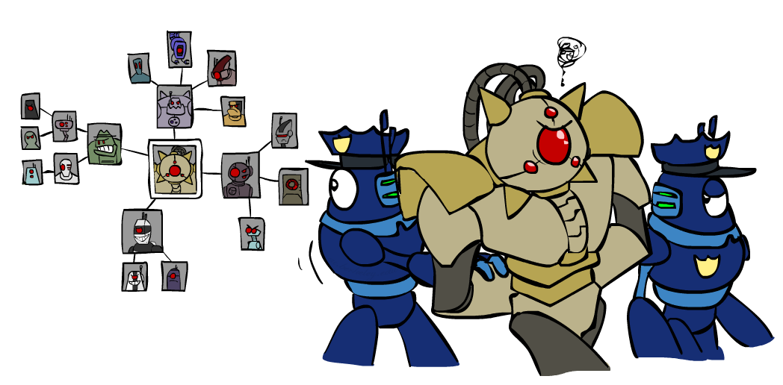
Improving Structure

Slide 22
Nearly Tree-Structured CSPs
Conditioning: instantiate a variable, prune its neighbors' domains
Cutset conditioning: instantiate (in all ways) a set of variables such that the remaining constraint graph is a tree
Cutset size c gives runtime O( (d^{c}) (n-c) d² ), very fast for small c

Slide 23
Cutset Conditioning
Choose a cutset
SA
Instantiate the cutset (all possible ways)
SA
SA
SA
Compute residual CSP for each assignment
Solve the residual CSPs (tree structured)

Slide 24
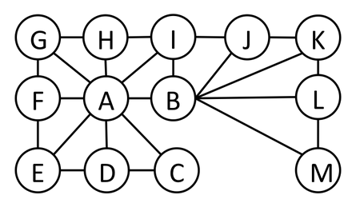
Cutset Quiz
Find the smallest cutset for the graph below.

Slide 25
Tree Decomposition*
Idea: create a tree-structured graph of mega-variables
Each mega-variable encodes part of the original CSP
Subproblems overlap to ensure consistent solutions
M1
M2
M3
M4
WA
≠
NT
NT
≠
Q
Q
≠
NSW
NSW
≠
V
≠
≠
≠
≠
≠
≠
≠
≠
SA
SA
SA
SA
Agree on shared vars
Agree on shared vars
Agree on shared vars
{(WA=r,SA=g,NT=b),
(WA=b,SA=r,NT=g),
…}
{(NT=r,SA=g,Q=b),
(NT=b,SA=g,Q=r),
…}
Agree: (M1,M2) ∈
{((WA=g,SA=g,NT=g), (NT=g,SA=g,Q=g)), …}

Slide 26
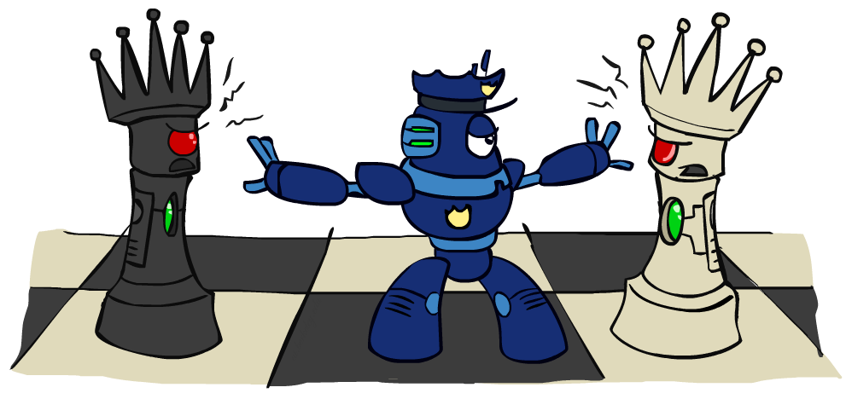
Iterative Improvement

Slide 27
Iterative Algorithms for CSPs
Local search methods typically work with “complete” states, i.e., all variables assigned
To apply to CSPs:
Take an assignment with unsatisfied constraints
Operators reassign variable values
No fringe! Live on the edge.
Algorithm: While not solved,
Variable selection: randomly select any conflicted variable
Value selection: min-conflicts heuristic:
Choose a value that violates the fewest constraints
I.e., hill climb with h(n) = total number of violated constraints

Slide 28
Example: 4-Queens
States: 4 queens in 4 columns (4⁴ = 256 states)
Operators: move queen in column
Goal test: no attacks
Evaluation: c(n) = number of attacks
[Demo: n-queens – iterative improvement (L5D1)]
[Demo: coloring – iterative improvement]
Notes:
L5D1 – python demos
Coloring – javascript demos

Slide 29

Video of Demo Iterative Improvement – n Queens

Slide 30
Video of Demo Iterative Improvement – Coloring

Slide 31
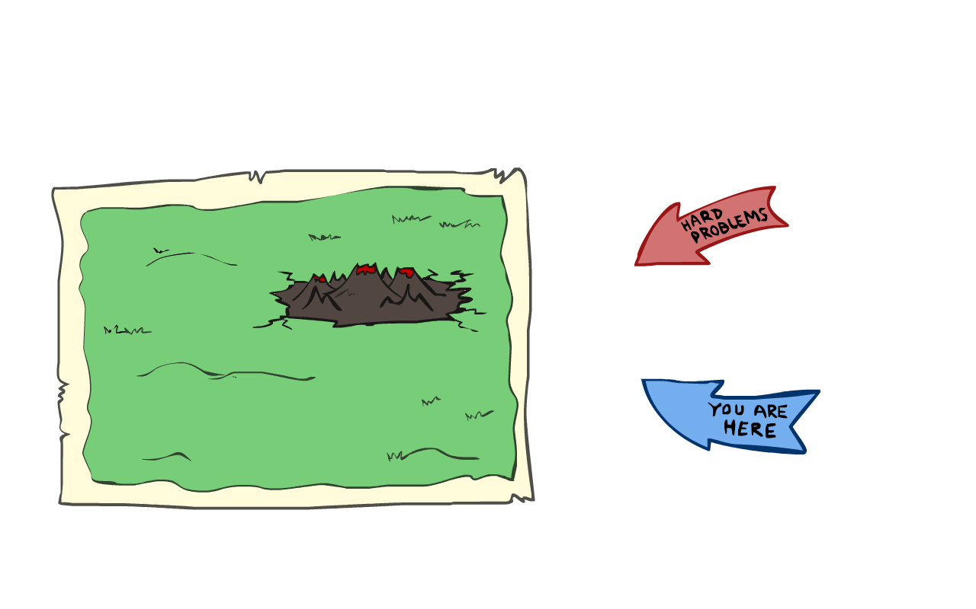
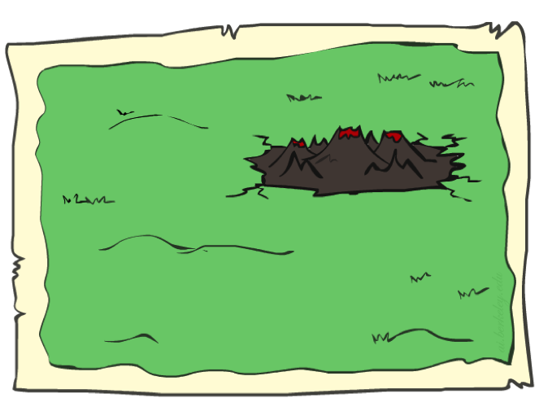
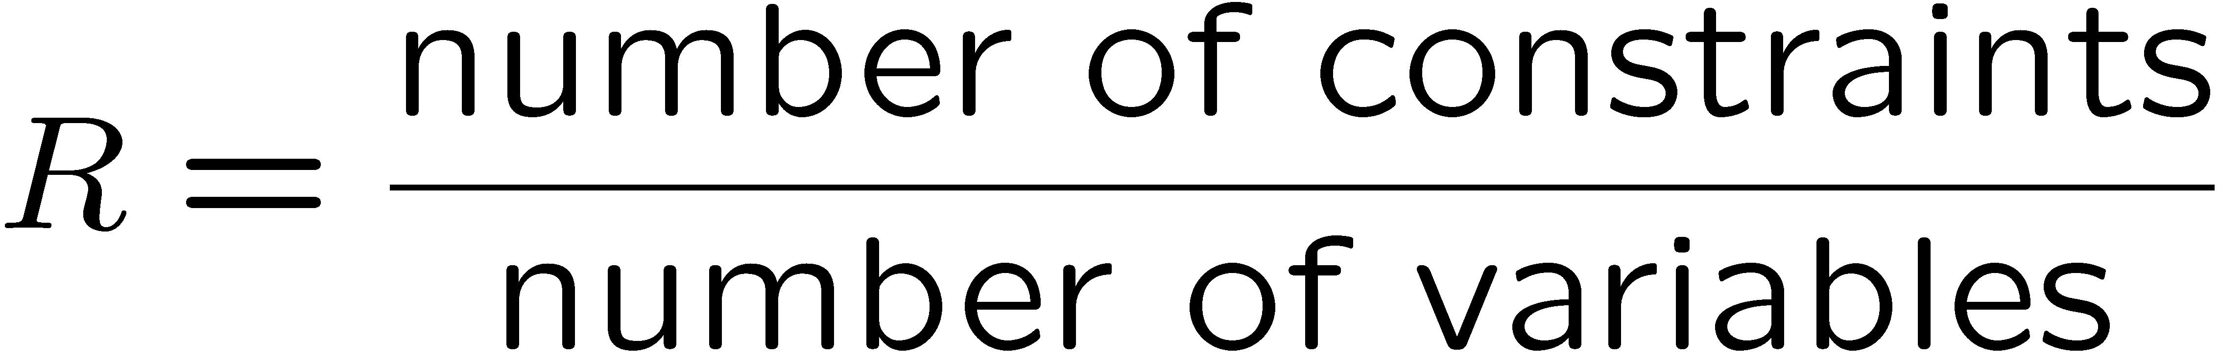
Performance of Min-Conflicts
Given random initial state, can solve n-queens in almost constant time for arbitrary n with high probability (e.g., n = 10,000,000)!
The same appears to be true for any randomly-generated CSP except in a narrow range of the ratio

Slide 32
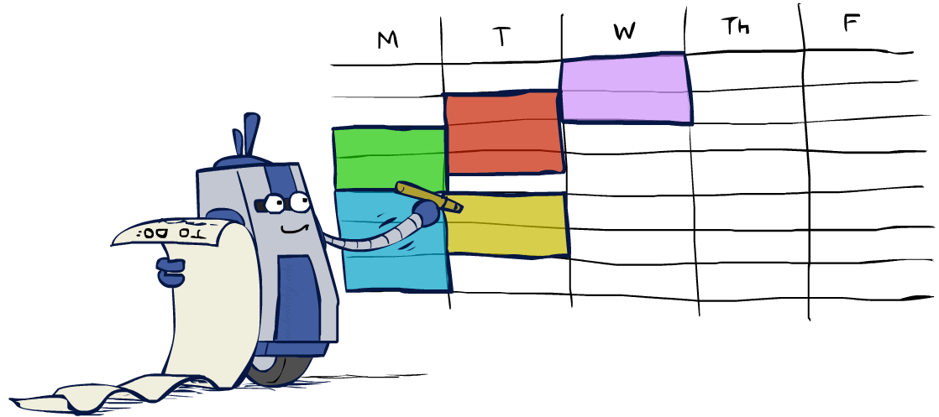
Summary: CSPs
CSPs are a special kind of search problem:
States are partial assignments
Goal test defined by constraints
Basic solution: backtracking search
Speed-ups:
Ordering
Filtering
Structure
Iterative min-conflicts is often effective in practice

Slide 33
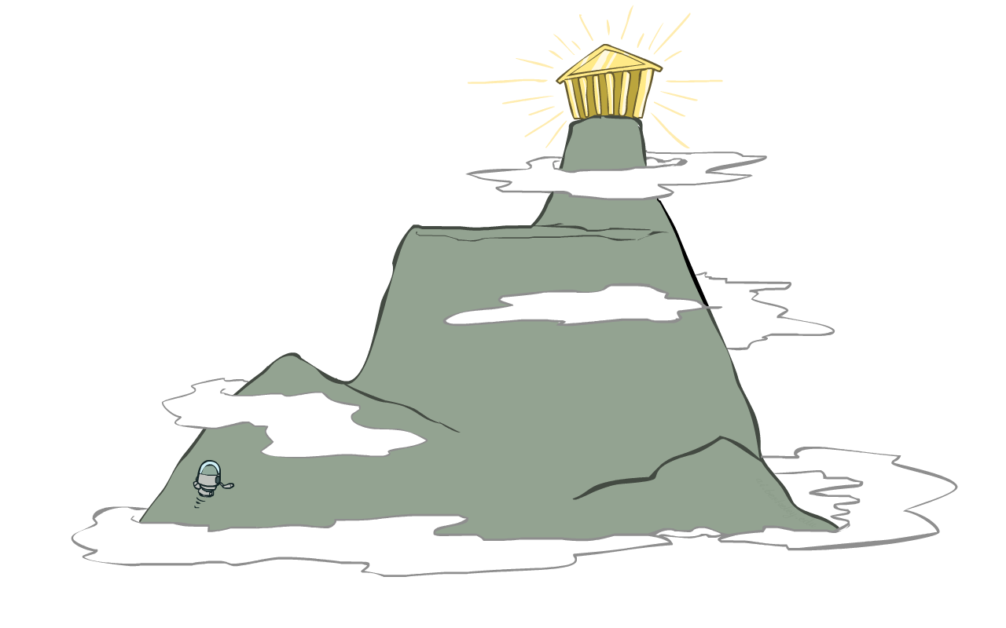
Local Search

Slide 34
Local Search
Tree search keeps unexplored alternatives on the fringe (ensures completeness)
Local search: improve a single option until you can’t make it better (no fringe!)
New successor function: local changes
Generally much faster and more memory efficient (but incomplete and suboptimal)

Slide 35
Hill Climbing
Simple, general idea:
Start wherever
Repeat: move to the best neighboring state
If no neighbors better than current, quit
What’s bad about this approach?
Complete?
Optimal?
What’s good about it?

Slide 36
Hill Climbing Diagram

Slide 37
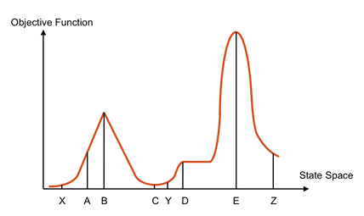
Hill Climbing Quiz
Starting from X, where do you end up ?
Starting from Y, where do you end up ?
Starting from Z, where do you end up ?

Slide 38

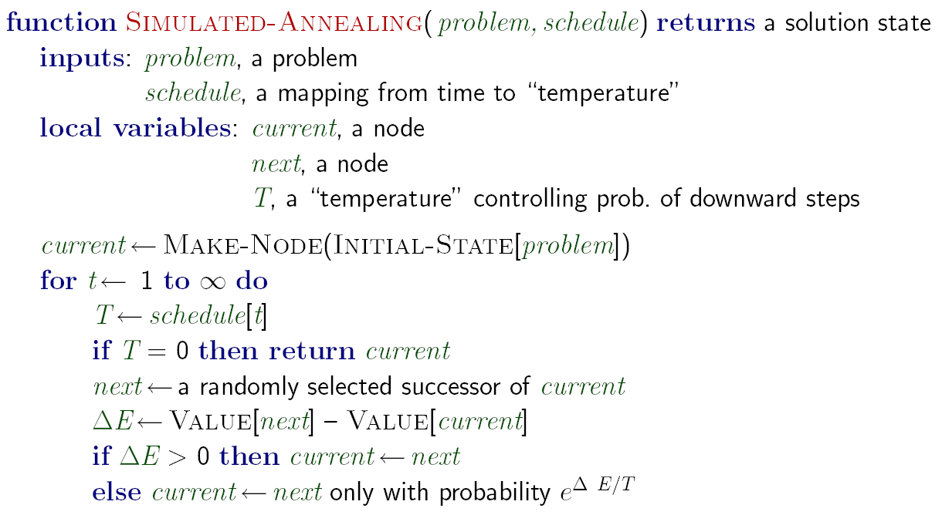
Simulated Annealing
Idea: Escape local maxima by allowing downhill moves
But make them rarer as time goes on

Slide 39
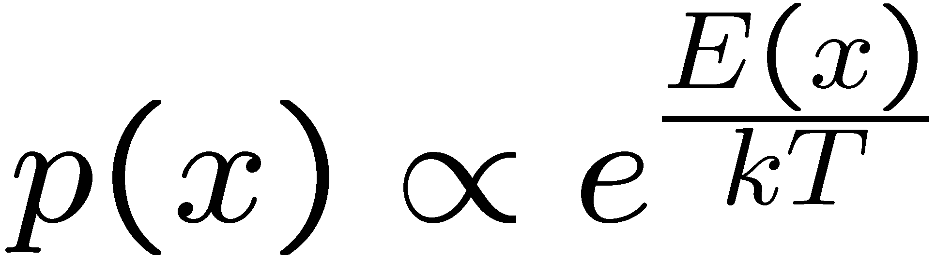
Simulated Annealing
Theoretical guarantee:
Stationary distribution:
If T decreased slowly enough,
will converge to optimal state!
Is this an interesting guarantee?
Sounds like magic, but reality is reality:
The more downhill steps you need to escape a local optimum, the less likely you are to ever make them all in a row
People think hard about ridge operators which let you jump around the space in better ways

Slide 40
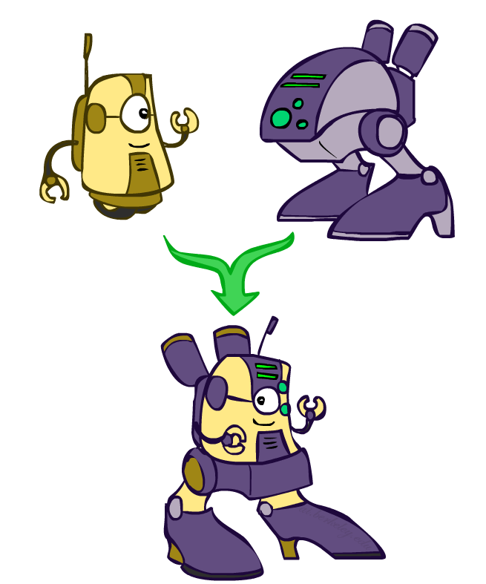
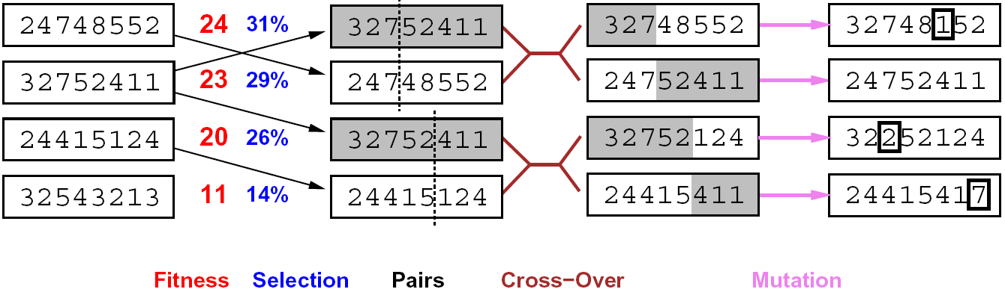
Genetic Algorithms
Genetic algorithms use a natural selection metaphor
Keep best N hypotheses at each step (selection) based on a fitness function
Also have pairwise crossover operators, with optional mutation to give variety
Possibly the most misunderstood, misapplied (and even maligned) technique around

Slide 41
Example: N-Queens
Why does crossover make sense here?
When wouldn’t it make sense?
What would mutation be?
What would a good fitness function be?

Slide 42
Next Time: Adversarial Search!

Slide 43
Example: Fault Diagnosis
Causes
Symptoms
Fault networks:
Variables?
Domains?
Constraints?
Various ways to query,
given symptoms
Some cause (abduction)
Simplest cause
All possible causes
What test is most useful?
Prediction: cause to effect
We’ll see this idea again with Bayes’ nets
SMTP down
Can’t email
DNS down
Can’t IM
Firewall blocking
Can’t print
Printer jam

Slide 44
Beam Search
Like greedy hillclimbing search, but keep K states at all times:
Variables: beam size, encourage diversity?
The best choice in MANY practical settings
Complete? Optimal?
Why do we still need optimal methods?
Greedy Search
Beam Search

